Slide 1





Slide 2

INTRODUCTION

Slide 3


TASK ALLOCATED Understanding TradingView Screener
Utsav Dhillon
utsavd987@gmail.com
Python Developer Intern at Hackveda

Slide 4
TABLE OF CONTENT
Introduction
Understanding Trading View Screener
Advantages of Trading View Screener
Alternatives
Demo
Restrictions
Conclusion and Use Case
Q&S session

Slide 5
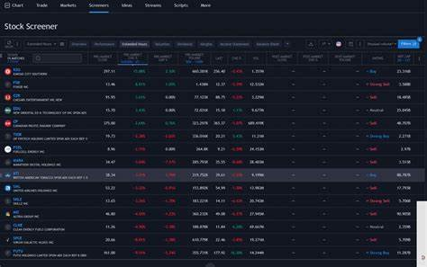
TRADINGVIEW SCREENER
TradingView is online stock-picking software and screener for both beginners and experienced active traders. It helps you combine various types of cloud-based charting tools for research. It provides users the ability to share and collaborate with other online traders.
Millions of traders use these curves, lines, and patterns as indicators to help them trade and study historical indices or stock movements.

Slide 6
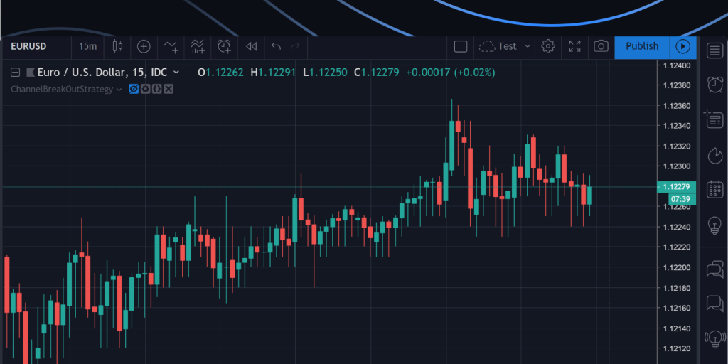
ADVANTAGES
User Friendly Interface
Versatility
Customization
Alerts
Community Sharing

Slide 7

ALTERNATIVES
There are many Tradingview alternatives available in India:-
1. GoCharting:- GoCharting is a cutting-edge charting, trading, and analytics platform that runs on both web and mobile platforms and supports all asset classes and multiple exchanges, including NSE and MCX.
2. Investing .com:-Investing .com provides charts, financial tools, breaking news, and analysis for 250 exchanges worldwide. It covers the global markets as well as commodities, cryptocurrencies, world indices, world currencies, futures, and options.

Slide 8
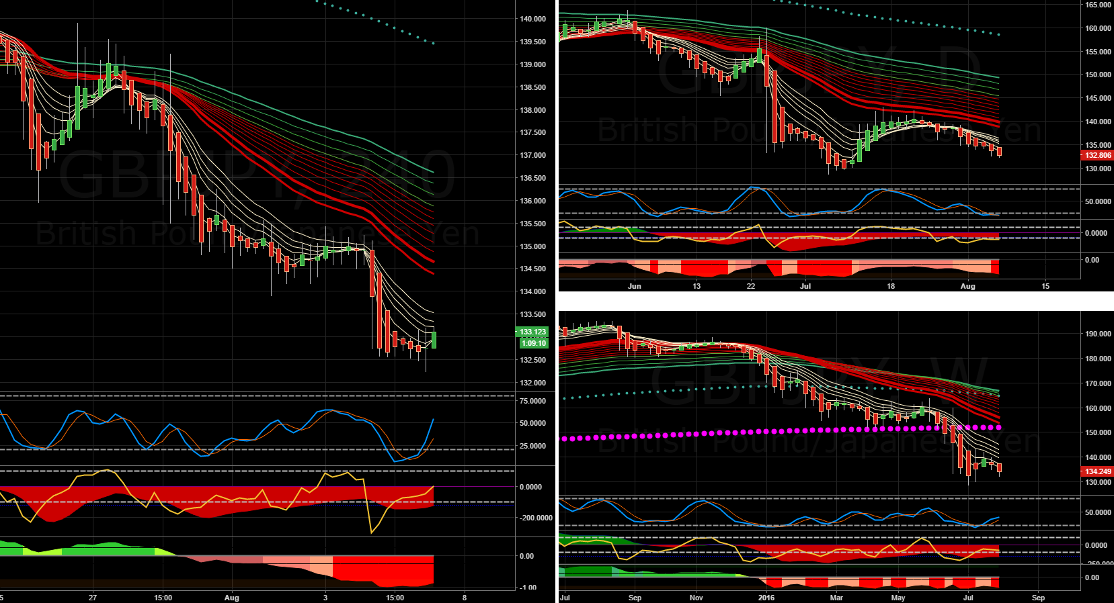
HOW TO USE TRADINGVIEW SCREENER
Step-by-step guide on creating a basic screener:
Selecting the market (stocks, forex, cryptocurrencies)
Setting filters (technical indicators, fundamental data)
Saving and naming the screener

Slide 9

DEMO

Slide 10

RESTRICTION
Limited in Free Version
Pay for advanced features
Limited Technical Indicators
Delayed Data
Ads

Slide 11

Conclusion
TradingView's screener tool is a powerful feature that allows traders and investors to filter and screen stocks, forex pairs, cryptocurrencies, and other assets based on various criteria.
TradingView's screener is a valuable tool for traders and investors, offering a wide range of customization options and market coverage. However, users should be aware of the limitations of the free version and the complexities involved in effective screener usage.

Slide 12

REFERENCE
Stock Screener: Search and Filter Stocks — TradingView India
https://www.youtube.com/results?search_query=tradingview+screener
https://www.reddit.com/

Slide 13


ANY QUESTIONS??
Connect with me: utsavd987@gmail.com

Slide 14

THANK YOU

